Slide 1
Predictive Analysis of Diabetes
Rutuja Jadhav – A20539073
Motupalli Lakshmi Lahitha – A20550762
Lekhana Sai Mikkilineni – A20545604
Deepika Regulavalasa – A20526663

Slide 2
Introduction
Objective: To analyze diabetes data and predict outcomes using machine learning.
Scope: Data preprocessing, visualization, unsupervised clustering, and classification models.

Slide 3
Dataset Overview: The Diabetes Dataset contains 768 samples with 8 medical features, such as glucose levels, BMI, and age, and a target variable indicating diabetes presence (0 = Non-diabetic, 1 = Diabetic).
Why We Chose This Dataset: This well-structured dataset includes key medical indicators relevant to diabetes prediction, making it ideal for applying machine-learning techniques and generating actionable insights.
Dataset: diabetes.csv

Slide 4
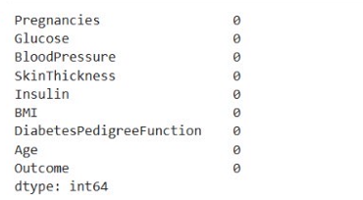
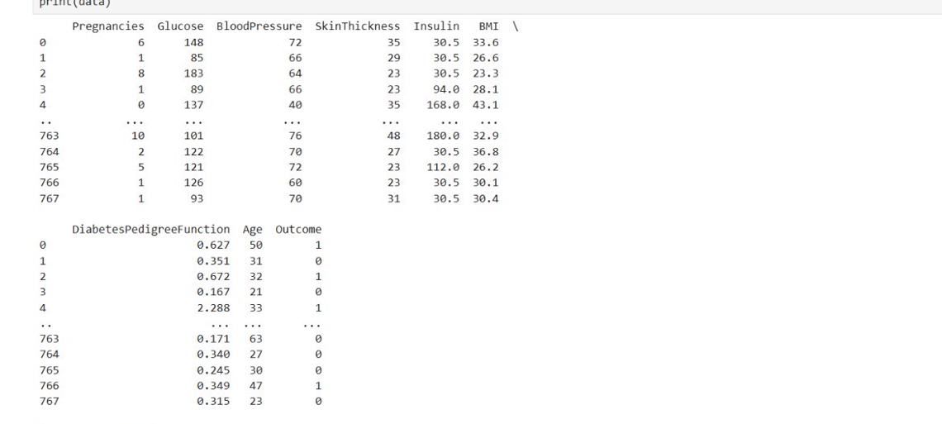
DATA PRE PROCESSING
Preprocessing steps, including handling missing values, normalization, and feature selection, improved data quality, reduced noise, and enhanced model accuracy and interpretability.

Slide 5
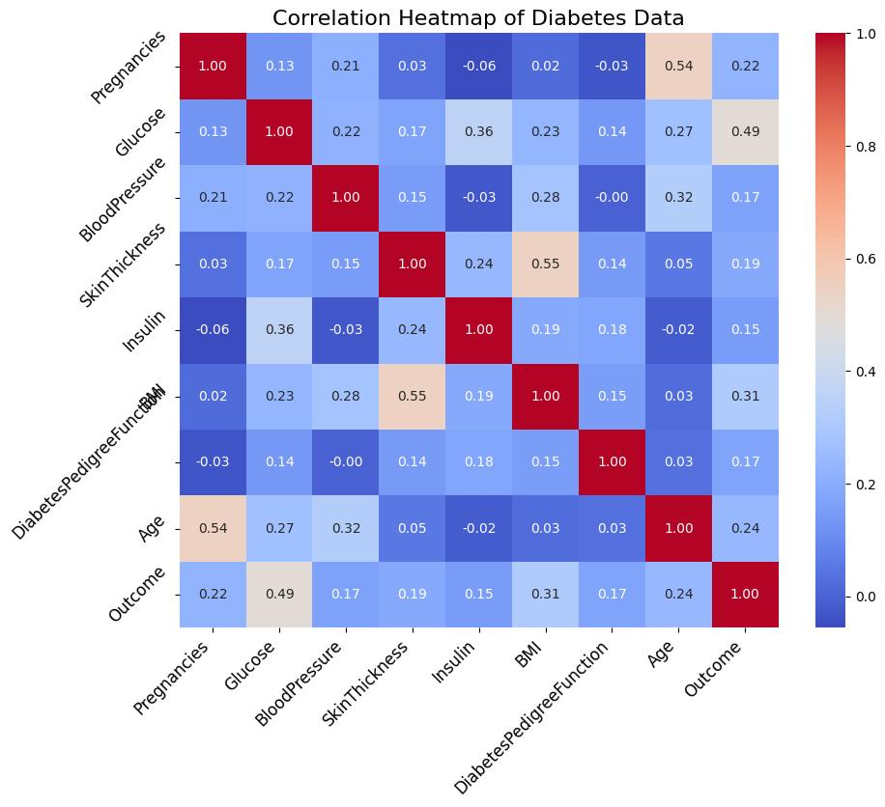
EXPLORATORY DATA ANALYSIS (EDA)
A heatmap revealed strong correlations, such as Glucose with Outcome and moderate ones like BMI with Diabetes Pedigree Function, while analysis highlighted class separability and preprocessing needs for Insulin.

Slide 6
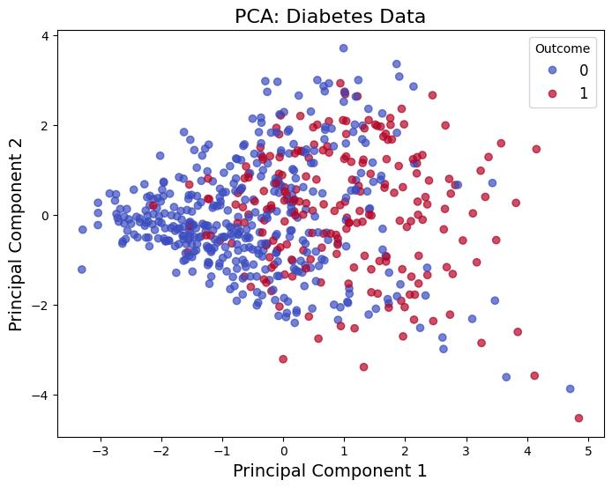
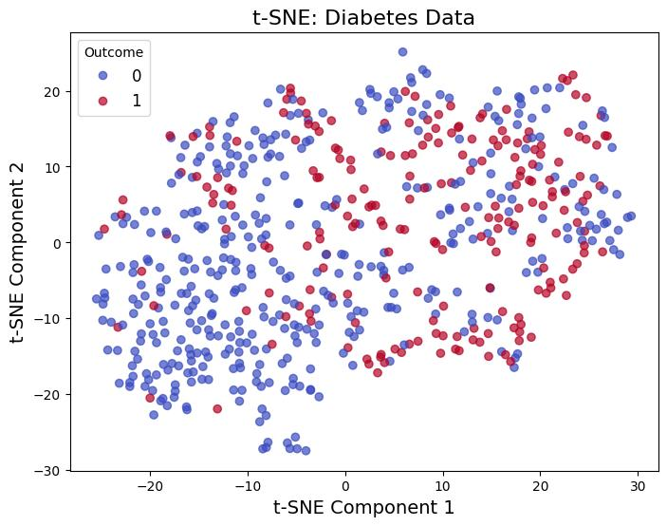
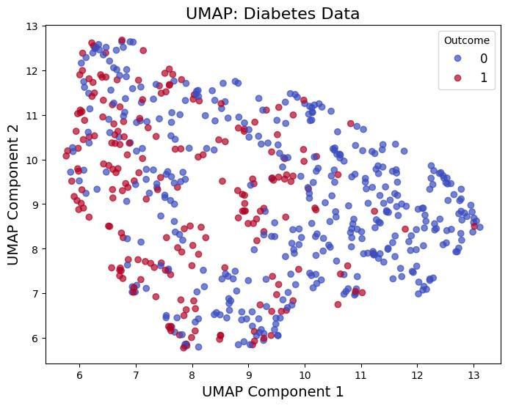
Dimensionality Reduction
PCA, UMAP, and t-SNE simplified data visualization, revealed class distinctions, and identified critical patterns for clustering and classification.

Slide 7
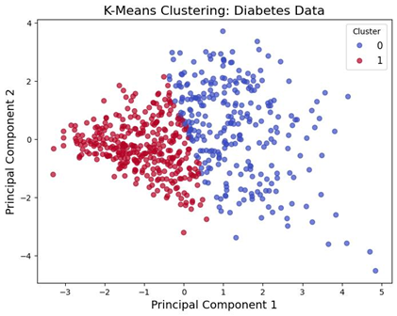
Unsupervised Learning
K-Means Clustering: Applied K-Means with 2 clusters to group data into diabetic and non-diabetic categories.
Visualization: Clusters were visualized using PCA components, highlighting distinct groupings.
Insights: Clustering confirmed feature-based separability, providing a foundation for further supervised learning analysis.

Slide 8
Supervised Learning
Models Used: Logistic Regression, Random Forest, and XGBoost were implemented to classify diabetic and non-diabetic cases.
Performance: XGBoost outperformed with the highest accuracy, while Random Forest provided key insights on feature importance.
Insights: Combining different models enhanced prediction reliability, showcasing the importance of feature engineering and model tuning.

Slide 9
Results and Insights
Model Performance:
XGBoost outperformed other models with an accuracy of 80.5%, followed by Random Forest at 79.7% and Logistic Regression at 76.6%.
Hyperparameter tuning improved Random Forest’s cross-validation accuracy to 81.2%, demonstrating the importance of parameter optimization.
Feature Importance:
Random Forest and XGBoost identified Glucose, BMI, and Insulin as the most influential features in predicting diabetes.
Feature selection experiments showed that focusing on top features enhanced model performance and reduced complexity.

Slide 10
Insights Gained:
Models accurately captured relationships between medical features and diabetes onset.
Dimensionality reduction techniques, clustering, and model tuning complemented each other in delivering robust predictions.
Key Takeaway: The results confirm that machine learning can provide actionable insights into diabetes risk factors, supporting early diagnosis and treatment.

Slide 11
Conclusion & Future Scope
Machine learning models, with XGBoost achieving 80.5% accuracy, identified Glucose, BMI, and Insulin as critical predictors for diabetes diagnosis.
Future work includes enhancing accuracy, integrating models into healthcare systems, and supporting public health initiatives.

Slide 12
THANK YOU

